Slide 1
Sharing helps relieving our pain
(A most neglected topic)

Slide 2
TIMETABLE
Introduction
Part 1-the beginning
Part 2-the conclusion
Part 3-the end…….

Slide 3
FACT-you might face these questions before reading the essay.
The 5 w’s:-
About whom and for what purpose is this story for?
Why is the writer writing this essay?
When did the writer write that?
Who is this person a girl or a boy?
{but don’t worry your questions will be answered…☺☺☺☺}

Slide 4
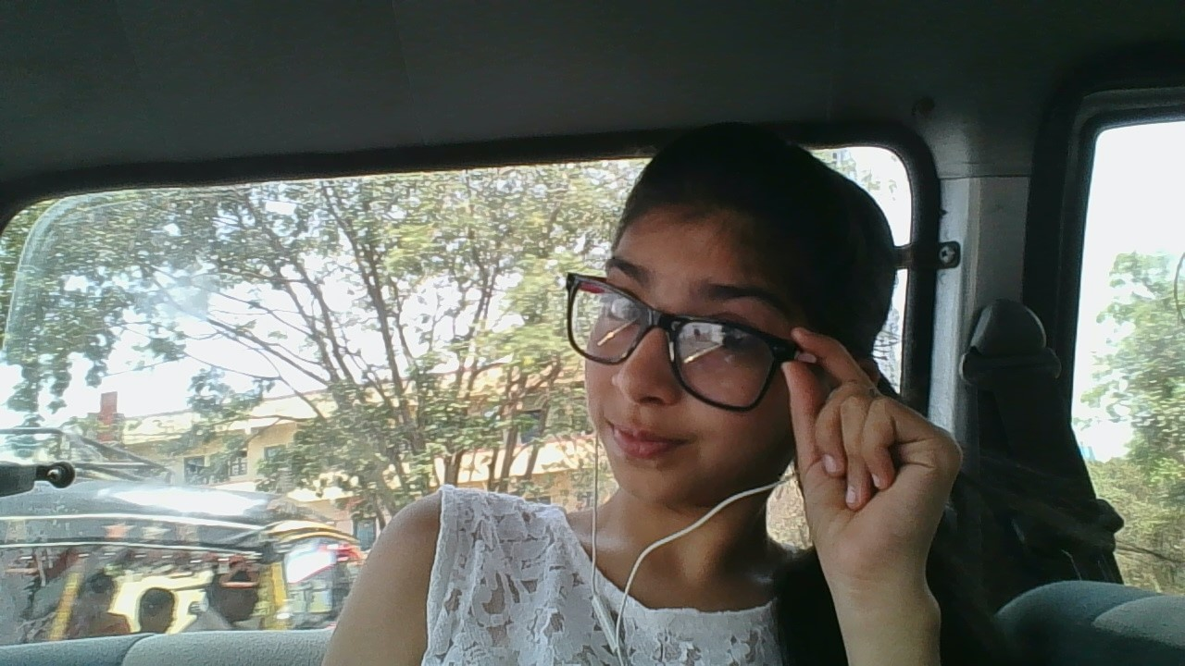
Introduction
Who is the writer?
Hello reader’s
I am Asha Rajgor and today I’m going to tell you about my struggle
and experience of Sharing things with others to create love and compassion
towards each others. this is a story from 2016-2017
☺

Slide 5
PART – 1
My journey
It was a really great morning.I used to follow my daily schedule like brusing teeth, having breakfast,and at 12:30 going to school as usual. It was 12:20 I was getting ready to go to school.After I reached school my sir named Anurag Chugh suddenly came and told me to wait after the school end’s.we usually used to call him bhaiya.He was and is my 2nd hero because he has done a really great work for us(students).he used to bring projector and in it we used to see English songs and we used to get taught by ppt’s.Today just because of him we are able to understand English songs like ‘hall of fame’,’demons’,’paradise’and many more.he just taught us for 2 years but he taught us so much that now we are speechless to describe him.really he is so incredible.he also taught us electronics .so this was about him. Now lets again get turned to the story.
we attended many lectures,free lectures and lunch and atlast at 5:30 our school ended.And I reached our computer lab as ordered by bhaiya.Bhaiya suddenly came with a bundles of papers and it contained all hardwords written by different teachers and bhaiya told me to type those words so that he can copy many papers filled with hardwords and hand it over to different classes students so that they can learn easily without completing anything.firstly bhaiya told me to call my parents by his phone and tell them that I’m going to be there in school with bhaiya to complete some school work.Anurag bhaiya was so cautious about letting parents know where their child is.I called my parents and asked for the permission.they both gave me permission. (continued on next page)

Slide 6
Part-1 continued
Bhaiya at first gave me 4 sheets.2 of English and 2 of science to type in computer and then he would copy many sheets to distribute it to students. It were of different standards like 5th,6th,7th,8th,9th and 10th.Every sheets of different std contained hundreds of hardwords.it took me 2 hours to type 3 and a half sheets of 100 words each.i told bhaiya that I am done with almost 3 and a half sheet he was also busy in doing some other work.he suddenly looked at me and said “All done?” I answered” yes” he gave a big smile and told “I’m proud of you Asha”I was really happy to hear that. After that he left me at my home in his car. The next day again as per the everyday schedule and again I waited for typing but this time the typing work got a little harder.I was given a task of typing in hindi and Marathi alsothat day there were many students who were typing with me but I was the only one whom bhaiya thought that will be able to do.Firstly he taught me about how to write in hindi and then Marathi it took me almost a week to type hindi’s hardwords sheets for every std students bhaiya was super duper glad with my work. After that there were again many more sheets of Marathi it was the same format but the words were a little different, this time bhaiya told me to share this work with my classmates. My job was to teach others about typing different words and guide them about some errors while typing. After I taught them the work was distributed in 4 to 6 students everyone was given 2 sheets for typing on different computers.the work then was completed in one shot it took me 1 day for typing 2 sheets of Marathi and others took 2 day because it was newly introduced to them.

Slide 7
PART-2
After some days my grandma got sick I and my mom took her to the doctor the doctor said that she has got malaria “that’s good that you took her quick to me”the doctor said . she gave medicines and food schedule,etc.after that she asked my mom about does she knows typing or not because she needed a girl who can type in their clinic the job was only to type the receipt of the patients and maintain a file regarding it .my mom said no I can’t manage because I already go to a job.After some days I got sick and I visited the doctor and then she told me that your tonsils are really getting worst thatswhy your throat always pains.And then she asked me for the job.i was just not able to imagine that I would get a job of typing in a clinic.i was just amazed.After that I told her that I can manage the weekend but I can manage 2 days and that are Saturday and Sunday. She said ok but it will be a lot of burden.Will you be able to handle it ? i answered yes . nd also let me ensure that from my parents she said yes . And I joyfully left from there and the first thing that I did was I called my dad even he agreed and gave me permission the next day I visited her again I said that yes my parents are comfortable with it☺ I will come as a half day work on Saturday because of school and full day on Sunday.she agreed and then I asked about how much salary will you give me.Then she asked me how much do you want? I said 2000Rs she said nothing less? I said then 1800 is correct she said ok. You can join from next week onwards.I replied ok ma’am I joined the job on my first day I was taught how to fill up the receipt and save it in folder and keep records.I worked there for 3 months and earned 5400 Rs .I left the job because now its my tenth.

Slide 8
Part-3
After I learned typing in English,hindi and Marathi .bhaiya even taught me to write in Gujrati .There was chart of rating yourself by your habits and your behaviour.so bhaiya gave me a task of typing that chart in gujrati by the help of my mom I completed that task. bhaiya also gave me an idea of learning languages I even learned French and Spanish . I usually go to my village every year and there is one school I had visited there and interacted with students also I taught them karate and football.firstly I had asked for fees but then I taught them for free because their parents can’t afford it.There I created a football team . I had a goal to play match with them and which they would defeat me and make me proud and this did happen ☺.this year also I had visited my hometown kutch it is in Gujrat and I am kutchi.i visited the school again.this time my aim was to help them by sharing my story books and some English and mathematics tips books and the money that I had earned I bought some pens,erasers,sharpners,pencils and scale that means that almost the whole compass box. I bought it and distributed to the students who were actually in need of it.everything in total cost 9000 my salary and my rakshabandhan money was spent into this but I was happy that I shared my happiness with others and made them happy and forgot all my circumstances and pain
WHENEVER YOU SHARE YOUR HAPPINESS WITH OTHERS THE OTHERS WOULD SHARE WITH many OTHER PEOPLE !!! LIKE THAT WE SHOULD SHARE OUR HAPPINESS TO BE HAPPY AND MAKE OTHERS HAPPY
A DREAM OF A HAPPY WORLD

Slide 9
HOPE THAT YOU LIKE MY REAL LIFE STORY AND SPREAD HAPPINESS EVERYWHERE
☺☺☺☺☺

